Slide 1
Bad actors

Slide 2
Pilot

Slide 3








Bad actors’ pilot
The pilot has been carried out on June, the 25-th, 2016.
During the pilot, we acquired hundreds of followers, and retweeters within Twitter from advertising third party services.

Slide 4



Bad actors’ pilot (cont.)
Eventually, we were able to acquire 4,160 users who followed our users, or retweeted our posts.
We defined these users as bad actors because they boosted our posts, and users for money what is users for money?. They boosted us artificially. They did not boost us because they think like us, or they are really our friends. – redundant in my opinion
From 4,160 bad actors:
440 users were found via VICO‘s feed.
3,716 users are defined as bad actors, but VICO‘s feed did not retrieve them.

Slide 5
Data collection

Slide 6
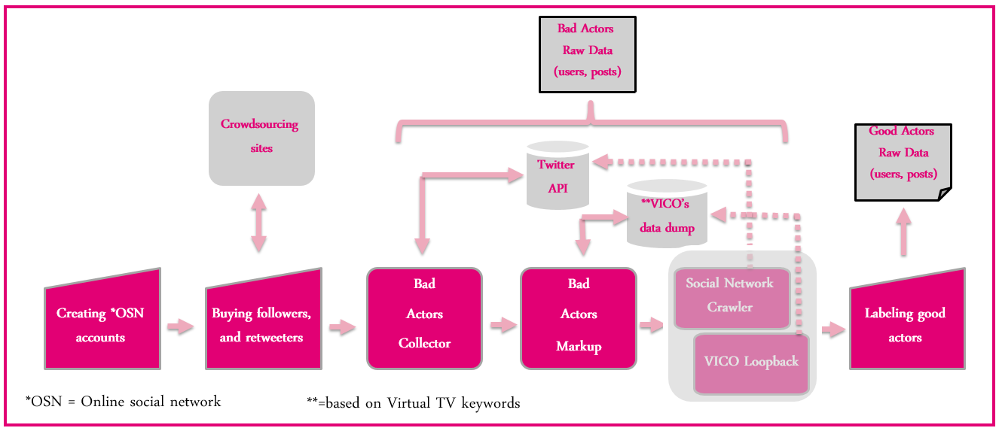
Data collection – short summary

Slide 7
Data collection
During data collection phase, we were able to collect great amount of information regarding authors, and posts.
From VICO’s feed we were able to find 13,251 users that their posts include data regarding ‘Virtual TV’ keywords.
Among them 9,338 were Twitter users
Among them were 9,225 users who are not suspended. – rewrite. You have among them twice ...
During the data collection we also used Missing Data Complementor (MDC) app for completing the missing information regarding the authors retrieved from VICO and, along with their followers, and their friends.
We were able to collect 592,098 Twitter users via MDC who have not been retrieved from VICO.
TwitterAPI
users
VICO’s users
The diagram is redundant as it is not understood…

Slide 8



Analysis Twitter users retrieved from VICO
For the analysis we used the 9,225 Twitter users who were retrieved via VICO’s feed and are not suspended.
We ran the DataSet Builder app for finding different features in order to distinguish between the authors.
VICO
Machine Learning Classifiers

Slide 9
Unsupervised learning

Slide 10
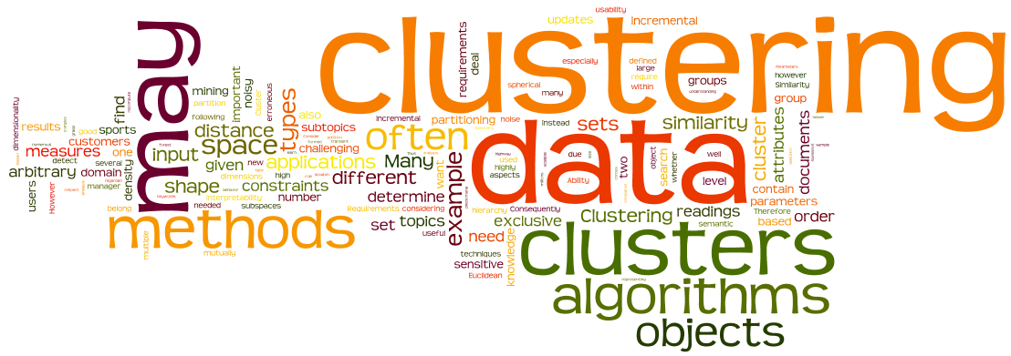
Primarily results
To better understand the nature of the Twitter authors retrieved from VICO’s feed, we manually investigated them via cluster analysis. How about: we used unseupervised learning algorithm to divide the authors into clustrers?
By this analysis we were able to divide users into different clusters.
Users in the same cluster share mutual features.

Slide 11
Cluster analysis
We used the Expectation-Maximization (EM) algorithm, and a set of features for representing each Twitter author to find groups of Twitter users who share similar appearances or behaviors. The sentence is not clear
Eventually, we were able to find 4 clusters:
% Bad actors | #Bad actors | Total | Clusters | No.
3.95% | 193 | 4886 | Cluster0 | 1
0% | 0 | 770 | Cluster1 | 2
8.127% | 244 | 3002 | Cluster2 | 3
1.172% | 7 | 597 | Cluster3 | 4
 | 444 | 9,255 |  | Sum

Slide 12
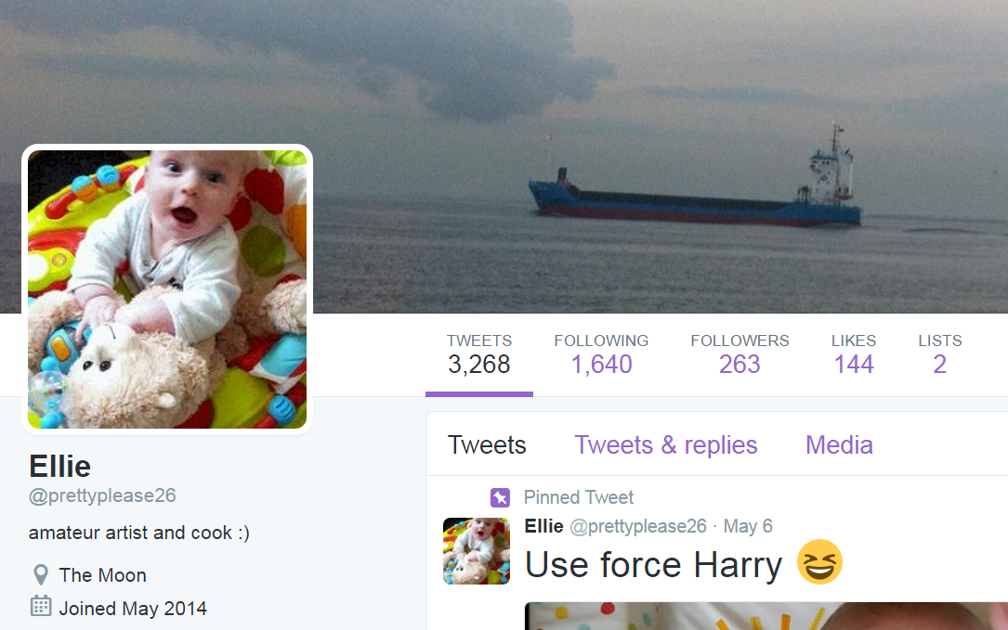
Cluster0 (Observing manually)
This cluster is varied so it is hard to tell exactly which users exist in this cluster.
Several users advertise commercials for doing Twitter actions like by RT, and follow for money.These users are probably crowdturfers.

Slide 13
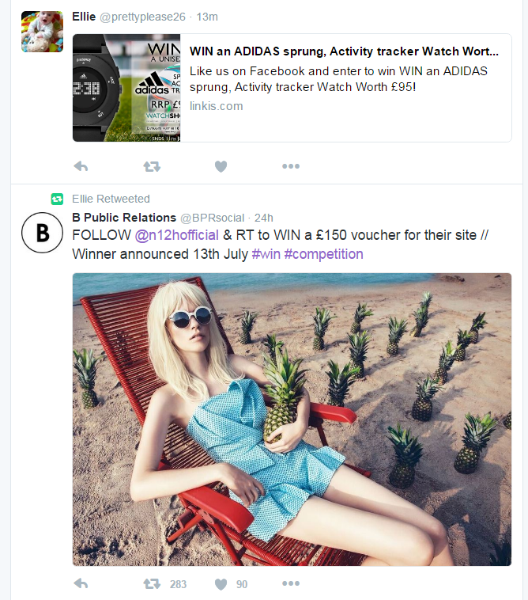
Cluster0 (Observing manually)

Slide 14
Cluster0 (main features)
Average age in days : 1370.58 ~ 3+ years old
Average post length : 14.0331 words
Average posts per day : 25.0849
Saved the default profile : 43.39% (Most of them changed their profile from default.)
Friends – followers ratio : 2.7026 (More friends than followers)
Average number of friends : 969.29
Average number of followers : 744.113
Average number of posts: 21,837.65

Slide 15


Cluster1 (Observing manually)
This cluster includes many users which are suspected by us to be new is it? We found that most of them are quite heavy users.
They have great number of followers, and friends.
They publish great number of posts.
This cluster includes many regular users who gained great effect within Twitter as well as companies, and news feed.

Slide 16
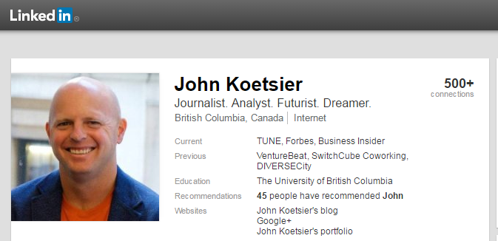
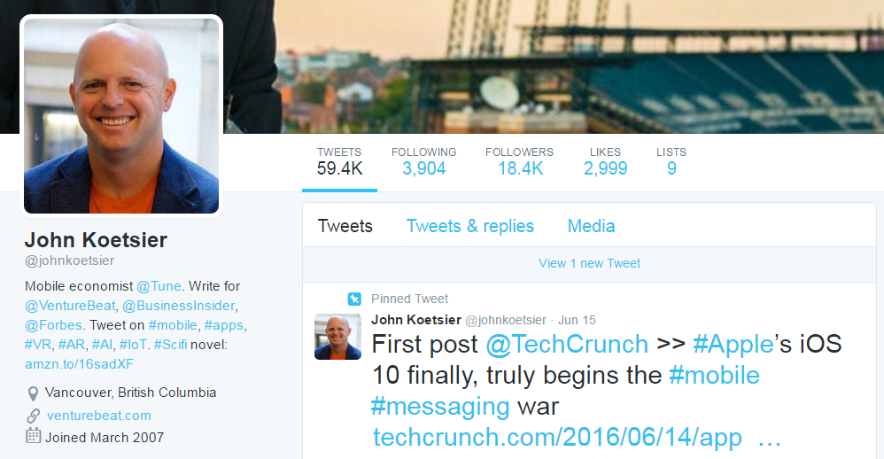
Cluster1 (Observing manually)
Several found to be regular users.
Many of them were found in other OSNs.

Slide 17
Cluster1 (main features)
Average age in days : 1377.78 ~ 3+ years old
Average post length : 14.46 words
Average posts per day : 250.45 (very active)
Saved the default profile : 0.39%.
Friends – followers ratio : 0.6596 (equal number between followers, and following)
Average number of friends : 4,233.58
Average number of followers : 21,749.65
Average number of posts: 135,379.1473

Slide 18

Cluster2 (Observing manually)
This cluster includes many users which are suspected to be newly profiles of socialbots.
Most of them are do not include too much information regarding themselves, simple default users, unrecognizable profile image.
Many of them have small number of posts, as well as followers.
Despite the small number of posts published by them, their most prominent activity is retweeting others’ posts. Probably as part of advertising campaigns.

Slide 19
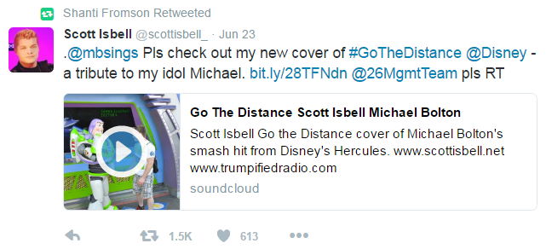
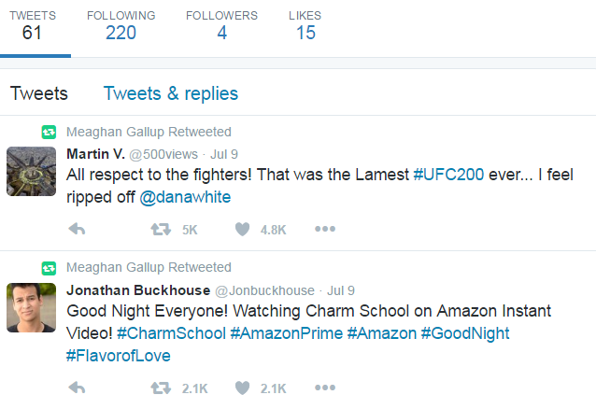
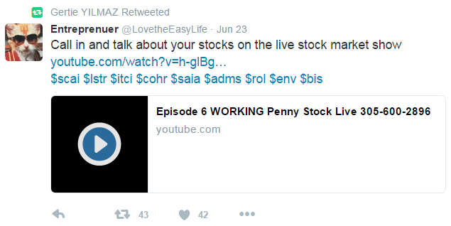
Cluster2 (Observing manually)

Slide 20
Cluster2 (main features)
Average age in days : 18.54 days (Extremely young )
Average post length : 10.77 words (Shorten than other clusters which has 14 words)
Average posts per day : 5.26 (Extremely inactive)
Saved the default profile : 0.98% (Not changed from default profile).
Friends – followers ratio : 59.33 (The users are more follow other users than other users follow them)
Average number of friends : 192.1462
Average number of followers : 4.442 (Extremely low number of followers)
Average number of posts: 148.7835 (Extremly low – other clusters more than ten of thousands)

Slide 21
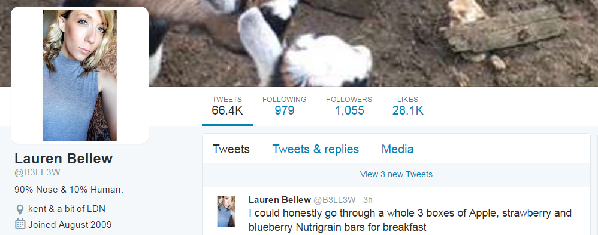
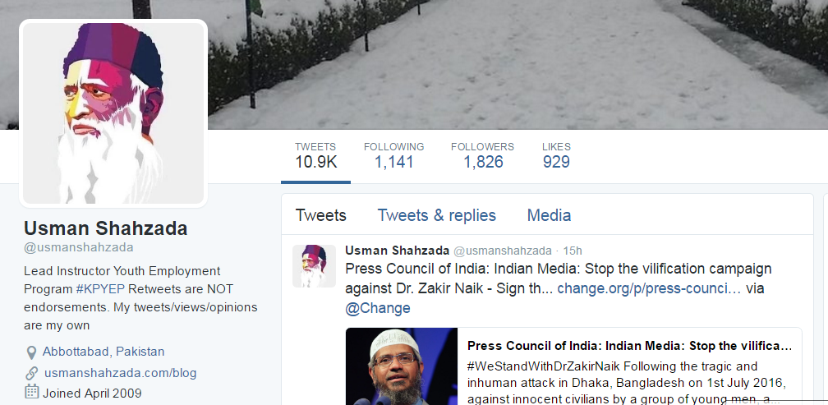
Cluster3 (Observing manually)
This cluster focuses on the great number of posts published by the users.
Some of them are found to be regular users who published posts all the day long.

Slide 22

Cluster3 (Observing manually)
Some of them were found to be merchandize promoter, which were created by merchandizers for promoting their goods.

Slide 23

Cluster3 (Observing manually)
Some of them were found to be crowdturfers, who published many posts for boosting others. Probably for money.

Slide 24
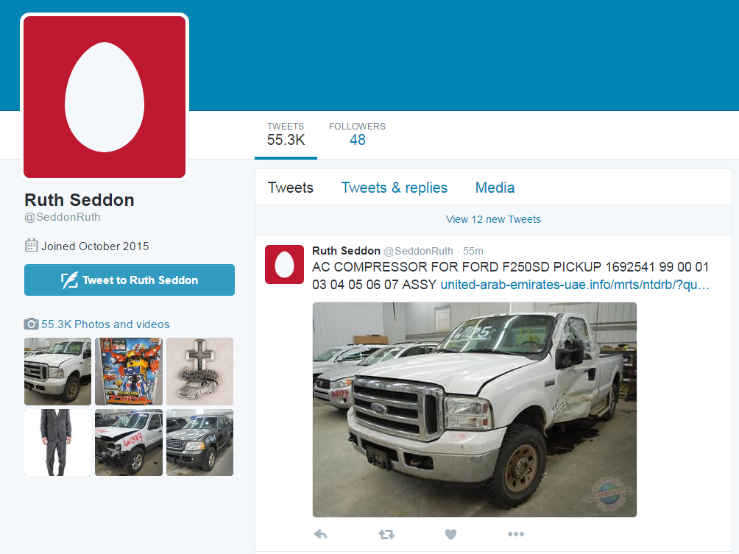
Cluster3 (Observing manually)
Some of them were found to be bots, which published many posts for diverted reasons.

Slide 25
Cluster3 (main features)
Average age in days : 920.91 days ~ 2.5 years old
Average post length : 10.77 words (Shorten than other clusters which has 14 words)
Average posts per day : 60.1778
Saved the default profile : 68.2%
Friends – followers ratio : 7.187 (The users are more follow other users than other users follow them)
Average number of friends : 733.0579
Average number of followers : 315.88
Average number of posts: 20,938.1729

Slide 26
Labeling good actors

Slide 27
Labeling good actors
In order to use supervised learning methods for studying users we have to gain a list of labeled good actors.
In these days we define descriptive rules for labeling good actors manually.
We will take the users from Cluster1, which were found to be regular users.
We will use the Committee of Experts method in order to find good actors.
Everyone of BGU team will label authors according to the rules that were determined.
Finally, we should gain authors that were labeled as good actors by every one of the experts.

Slide 28
Next steps

Slide 29

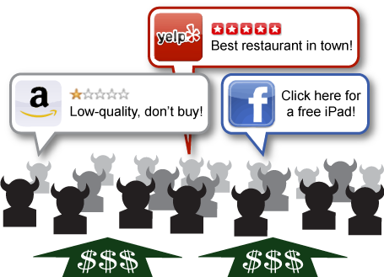




SUPERVISED AUTHORS CLASSIFICATION DIFFTRACK: Methodology.
Create labeled dataset
VICO
Train Machine Learning Classifiers
Test classifiers on real data operated by CRM

